Slide 1
P0361R1
Invoking Algorithms Asynchronously
Hartmut Kaiser, Thomas Heller, Bryce Adelstein Lelbach, John Biddiscombe, Michael Wong

Slide 2
Motivation
Parallel algorithms in C++17 are synchronous
Fork/join, imposes implicit barrier
Introduces implicit barrier impeding parallel efficiency
No means of controlling when and how this barrier is imposed
This paper introduces asynchronous algorithms
Algorithms return a future
Does not remove barrier, but allows to overlap the ‘tapering off’ with other work

Slide 3
New Execution Policies
Extensions: asynchronous execution policies
parallel_task_execution_policy (asynchronous version of parallel_execution_policy), generated with par(task)
sequential_task_execution_policy (asynchronous version of sequential_execution_policy), generated with seq(task)
parallel_unsequenced_task_execution_policy (asynchronous version of parallel_unsequenced_execution_policy), generated with par_unseq(task)
In all cases the formerly synchronous functions return a future<> representing the overall result
Instruct the parallel construct to be executed asynchronously
Allows integration with asynchronous control flow

Slide 4
Example
using namespace std::experimental::parallel::v1;
std::vector<int> data = { ... };
// NEW: asynchronous, sequential execution
std::future<void> f1 = sort(seq(task), data.begin(), data.end());
// ... perform other work
f1.get(); // synchronize with the asynchronous sequential sort()
// NEW: asynchronous execution, allow for parallelization of the algorithm
std::future<void> f2 = sort(par(task), data.begin(), data.end());
// ... perform other work
f2.get(); // synchronize with the asynchronous parallel sort()
// NEW: asynchronous execution, allow for parallelization and vectorization
// of the algorithm
std::future<void> f3 = sort(par_unseq(task), data.begin(), data.end());
// ... perform other work
f3.get(); // synchronize with the asynchronous parallel vectorized sort()

Slide 5
Extending Parallel Algorithms
New algorithm: gather
template <typename BiIter, typename Pred>
pair<BiIter, BiIter> gather(BiIter f, BiIter l, BiIter p, Pred pred)
{
BiIter it1 = stable_partition(f, p, not1(pred));
BiIter it2 = stable_partition(p, l, pred);
return make_pair(it1, it2);
}
Sean Parent: C++ Seasoning, Going Native 2013

Slide 6
Extending Parallel Algorithms (await)
New algorithm: gather_async
template <typename BiIter, typename Pred>
future<pair<BiIter, BiIter>> gather_async(BiIter f, BiIter l, BiIter p, Pred pred)
{
future<BiIter> f1 = parallel::stable_partition(par(task), f, p, not1(pred));
future<BiIter> f2 = parallel::stable_partition(par(task), p, l, pred);
co_return make_pair(co_await f1, co_await f2);
}

Slide 7
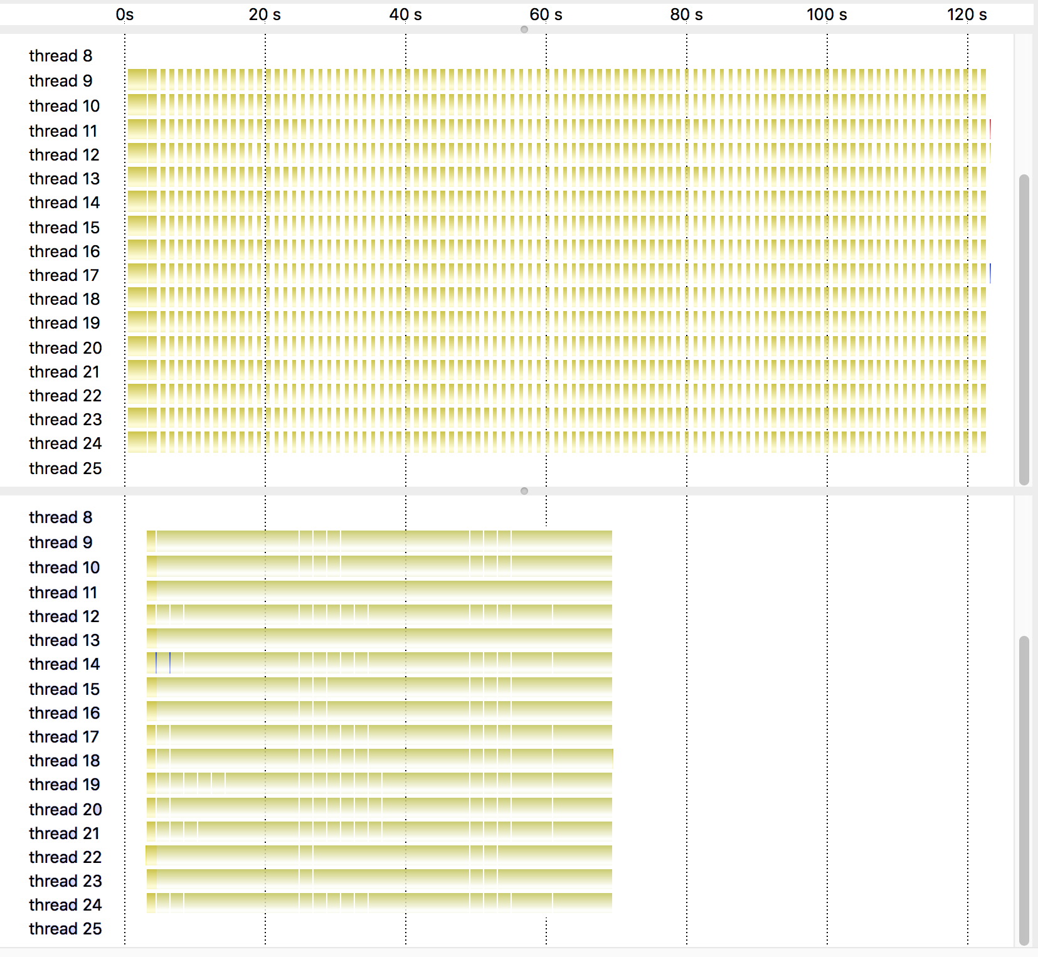
Implementation
Implementation experience in HPX
Use experience for 2 years in large scientific applications
Has shown to help improving parallel efficiency of applications by factor of 2
Figure shows the utilization of cores in a time-step based stencil code (~2000 distributed nodes), comparing synchronous and asynchronous operation
Nice overlap of computation and communication, etc.

Slide 8
Discussion
Use separate overloads for asynchronous algorithms instead of new execution policies
Rationale:
Asynchronous algorithms may need different set of algorithms
This is certainly a possible solution
Prevents generic programming
In our implementation we have seen no need for different set of arguments

Slide 9
Discussion
Do not introduce asynchronous algorithms now as those may be subsumed by core language functionalities (such as suspendable functions, see [P0071R2]) which are currently proposed and under discussion.
Asynchronous algorithms are a feature requested by several people in SG1 and SG14.
We have solid implementation and usage experience
The suspendable functions proposal without any doubt has merit and may partially or fully subsume the features proposed
Requires compiler support
Unclear if and when available
No implementation experience
We would rather move forward with an existing and proven solution now to give users more experience with possible implementations

Slide 10
Discussion
Align asynchronous algorithms with networking TS
Additional parameter to decide whether to return a future or directly pass a continuation function
Asynchrony is much more than just attaching one continuation
Building dependency graphs for better resource utilization
Very limited added functionality with significant implementation overhead

Slide 11








